Slide 1
Baltic WEEE Workshop Taking on the e-waste challenge in the Baltics
1 October 2015 - Tallin, Estonia
Marta Yuste

Slide 2
About CECED

Slide 3
CECED
European Committee of Domestic Equipment Manufacturers
Representing home appliance industry in Europe
Main objective to safeguard & directly represent industry’s interests
Represents an innovative industry:
Track record of energy & environment good practices
Reducing environmental impacts while enhancing product performance

Slide 4
History
Founded 1959
Brussels operations since 1997
Membership expanded
Secretariat doubled in size in last few years

Slide 5
Facts & Figures
Important European economic player : Membership has a collective turnover of €48bn per annum (2013)
250,000 employed in EU & indirectly a further 750,000
1 job created in home appliance industry = 3-4 additional jobs created in wider economy
Sector contributes > 53.3bn euros to EU economy, generates 14bn euros in tax revenue annually & invests 1.4bn euros in R&D p/a.
Europe Economics report - The Economic Impact of the Domestic Appliances Industry in Europe (2015)

Slide 6
Product Scope
CECED members produce the following type of appliances:
Large appliances such as refrigerators, freezers, ovens, dishwashers, washing machines & dryers
Small appliances such as vacuum cleaners, irons, toasters & toothbrushes
Heating, ventilation & air conditioning appliances such as air conditioners, heat pumps & local space heaters

Slide 7
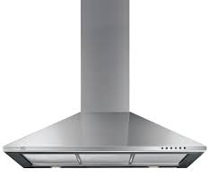
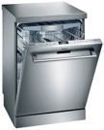
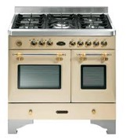
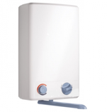
Large
Small
HVAC
60%
20%
20%

Slide 8
Direct Members
Notes:
CECED Direct Members are Arçelik, Ariston Thermo Group, BSH Bosch und Siemens Hausgeräte GmbH, Candy Group, Daikin Europe, De’Longhi, AB Electrolux, Gorenje, Indesit Company, LG Electronics Europe, Liebherr Hausgeräte, Miele & Cie. GmbH & Co., Philips, Samsung, Groupe SEB, Vorwerk and Whirlpool Europe.

Slide 9
National Associations (NA)
Notes:
CECED’s member Associations cover the following countries: Austria, Belgium, Bulgaria, Czech Republic, Denmark, France, Germany, Greece, Hungary, Italy, Netherlands, Norway, Poland, Portugal, Romania, Russia, Slovakia, Spain, Sweden, Switzerland, Turkey and the United Kingdom.

Slide 10
Proper Treatment of WEEE

Slide 11
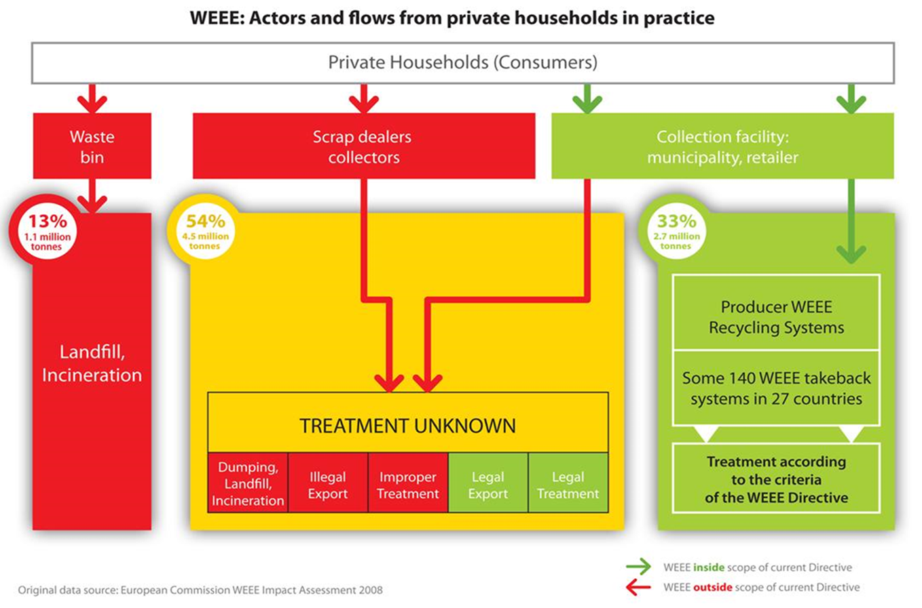
Key issues of WEEE II transposition
All WEEE flows

Slide 12
Key issues of WEEE II transposition
The new WEEE Directive created an opportunity to improve the performance of collection and treatment in Europe
Article 8.5 – European Standardisation Organisations to develop standards for treatment and preparation for re-use of WEEE
But only if
All flows of WEEE are collected and properly treated are reported and counted towards achievement of the targets set
This should be a key principle of national WEEE legislation

Slide 13
Why are WEEE Standards important?
Promote competiveness & encourage innovation
Allow benchmarking of WEEE collection, logistics & treatment services
Promote a common technical understanding
Improve the environmental performance of the overall WEEE chain
Level the playing field for operators working in the WEEE field

Slide 14
Why are WEEE Standards important?
Level the playing field
Harmonised treatment of WEEE across Europe
Not 28 different standards!!!
Reflect the state of the art
Ensure environmental protection
Proper treatment based on uniform harmonized standards promotes that the recycling and recovery quotas in WEEE treatment are met.

Slide 15
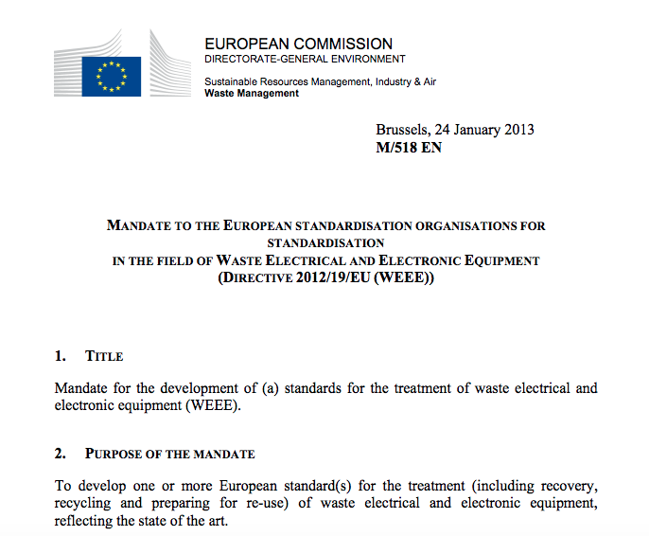
We are almost there
From WEEELABEX
Example of excellence
To EN Standards
Involvement of all relevant stakeholders

Slide 16
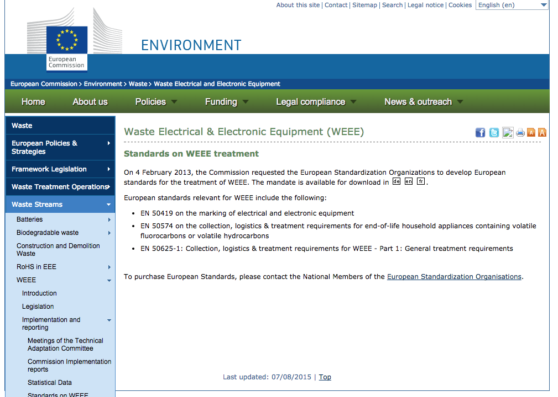
We are almost there
CEN-CENELEC TC111X Environment started to work when mandate accepted
AND IT’S ALMOST FINALISED - Q1 2016
CECED involved in writing standards

Slide 17
Last Step
Ireland, France, The Netherlands already implemented compliance with WEEELABEX and EN Standards in their national regulatory frameworks compulsory
CECED SUPPORTS TO MAKE COMPLIANCE WITH EN STANDARDS COMPULSORY AT EU LEVEL TO ENSURE HARMONISATION ACROSS EU
Art 8.5: […] In order to ensure uniform conditions for the implementation of this Article, the Commission may adopt implementing acts laying down minimum quality standards based in particular on the standards developed by the European standardisation organisations.

Slide 18
Thank you

