Slide 1

EPR
25 years of development
Baltic WEEE Workshop 1 October 2015
Thomas Lindhqvist
International Institute for Industrial Environmental Economics (IIIEE)
Lund University

Slide 2
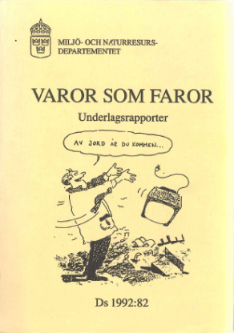
1990 – Extended Producer Responsibility
‘Förlängt producentansvar’ translated to EPR
Introduced in a report to the Swedish Ministry of Environment
During 1990s introduced in European policy debate and gradually beyond Europe

Slide 3
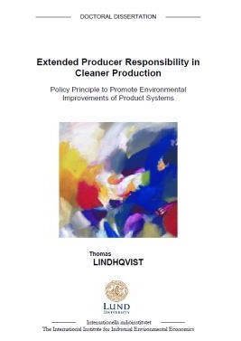
Why EPR?
From limited recycling to making re-use and recycling the main option
Prevent and facilitate recycling through design improvements
A need to create new incentives for market actors and in particular manufacturers

Slide 4
EPR for complex products
Relatively easy to formulate the goals for packaging and other “simple” products
More difficult to have reasonable and useful targets for complex products
Need for dynamic incentives, where producers are rewarded by cost savings

Slide 5
Successes in implementation
Many good recycling results
New industry created
Gradual improvements in collection and recycling
Global acceptance

Slide 6
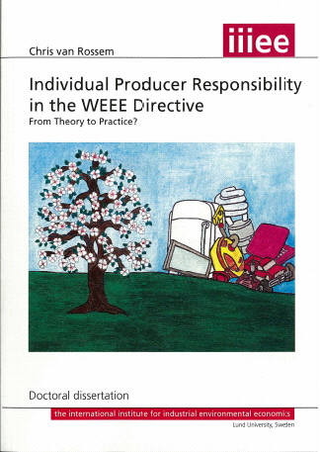
Individual Producer Responsibility
Two fundamental parts of WEEE Directive
Choice for manufacturers between collective and individual responsibility
Financial guarantees

Slide 7
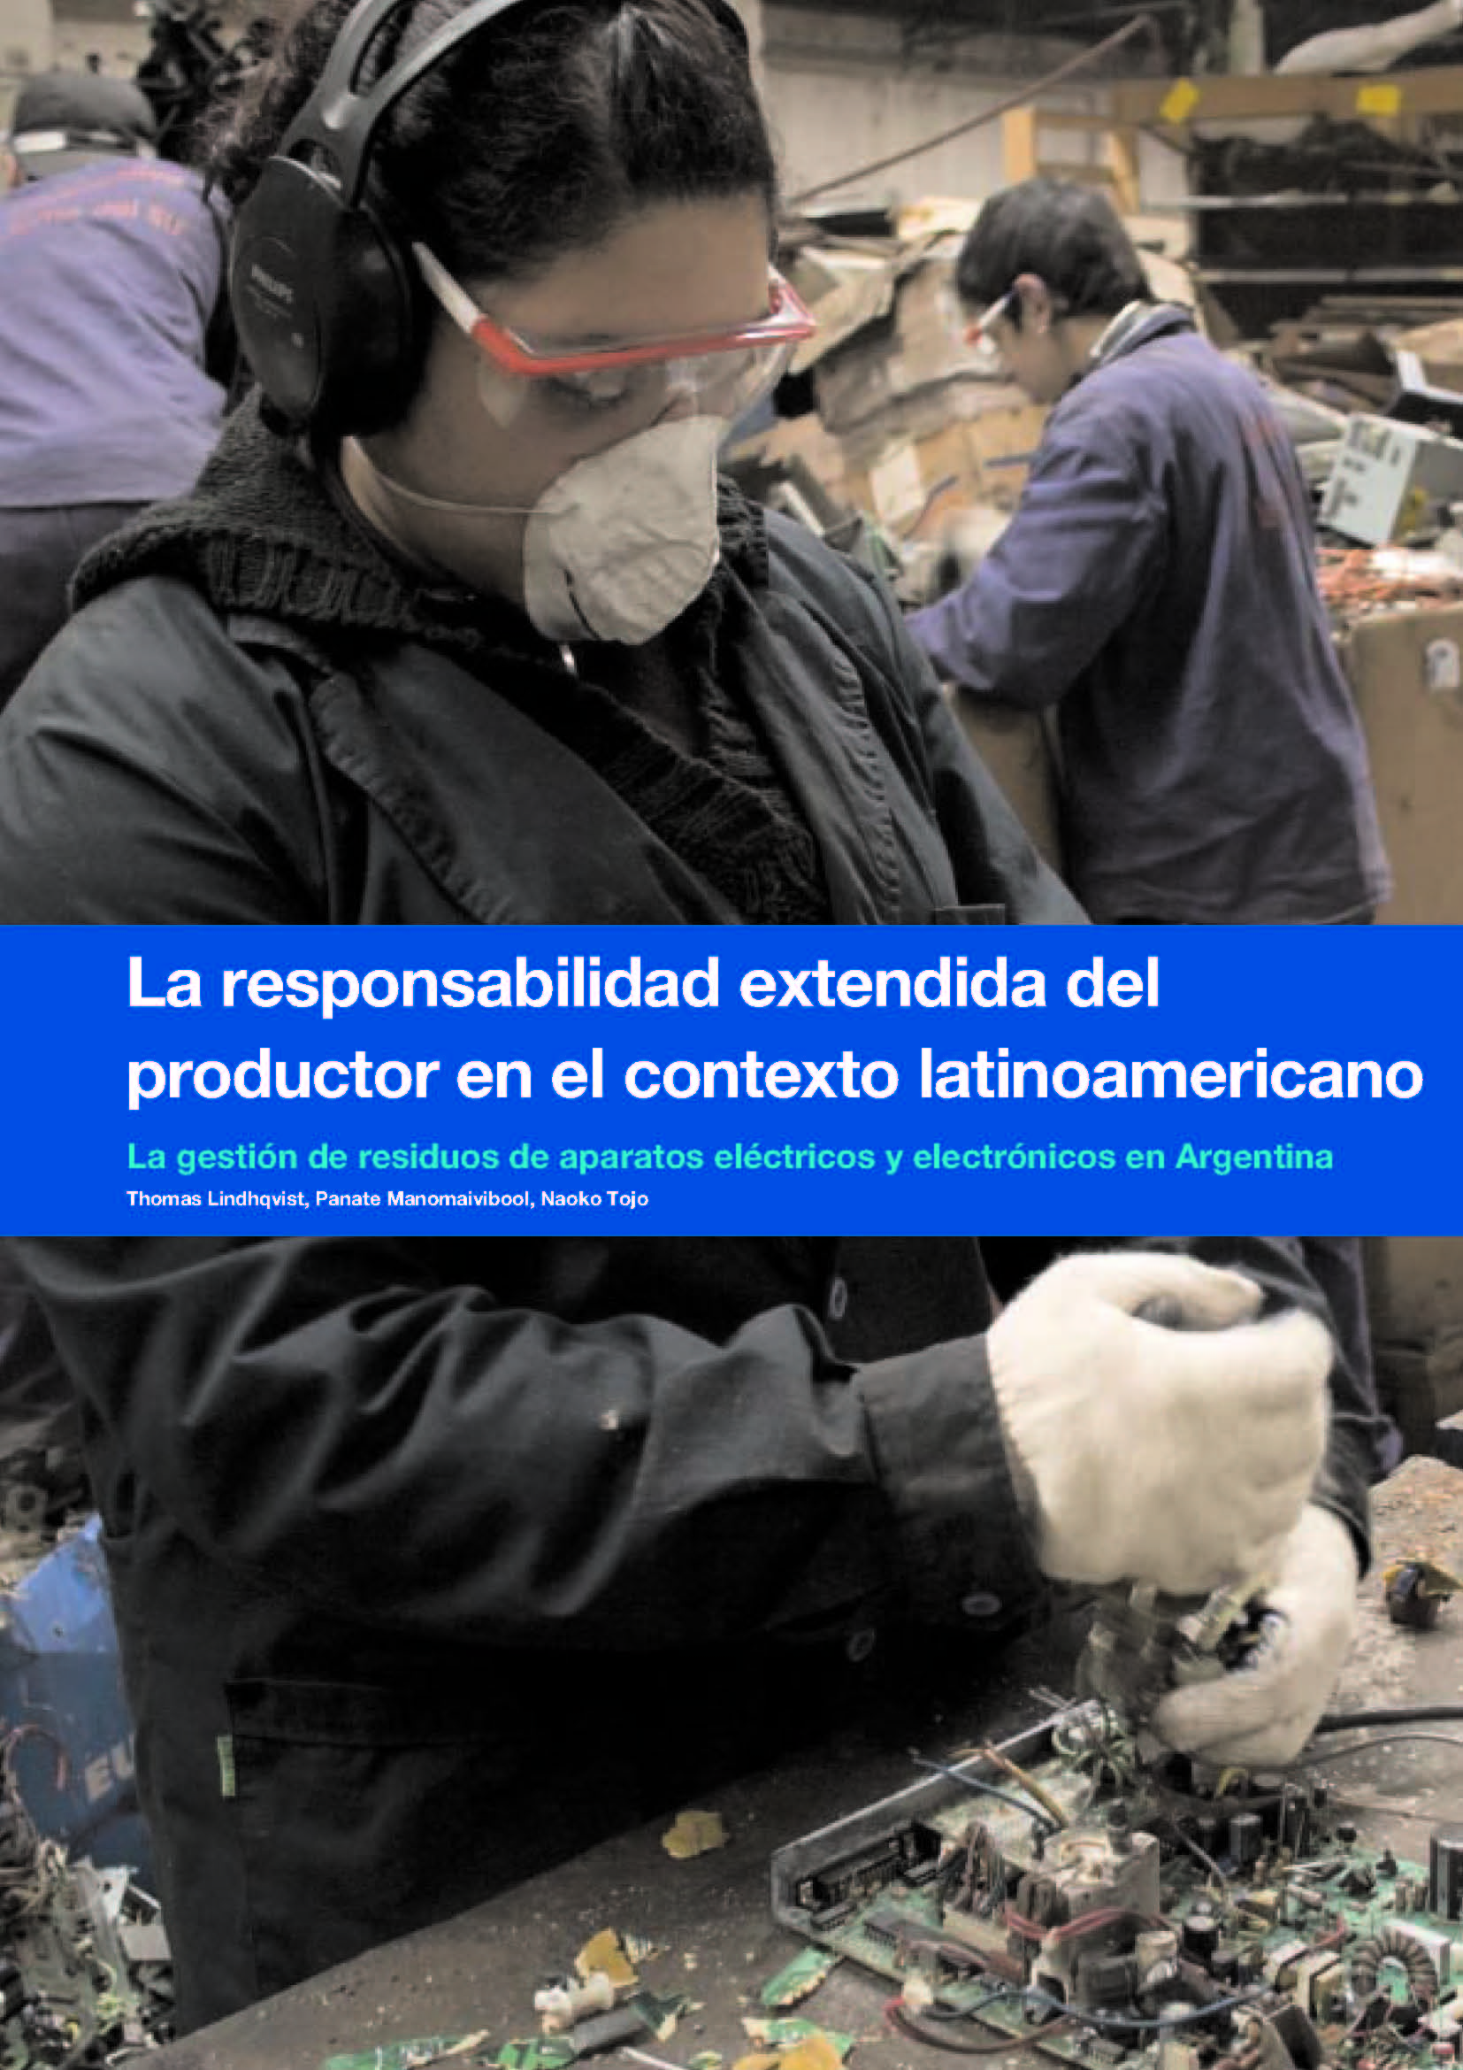
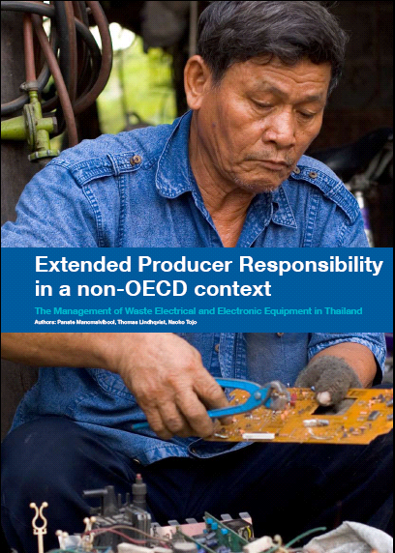
Transfer of problems
Important not to export the problems to non-OECD countries
Local capacities
Control

Slide 8
Problems in implementation
Focus on collection and simple recovery
Fear of new approaches
Compromises
Lack of control
Lack of monitoring
As a result, weak incentives for new design of products and take-back systems

Slide 9
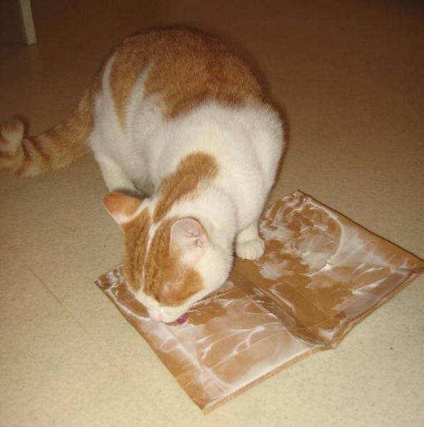
So …
When you work with EEE you should believe in change and technical development
Let’s also believe in opportunities for new and more sustainable products
And let’s have policies and practice that rewards such changes
Thank you for your attention!
There are win-win solutions to be discovered in many areas! As here, making recycling possible with clean yoghurt packaging, while also not losing product.

