Slide 1



- The WEEE chain of events -
Key findings and recommendations
Jaco Huisman (UNU)
Lucía Herreras (WEEE Forum)
Baltic WEEE workshop
Taking on the e-waste challenge in the Baltics
Tallinn, 1 October 2015
Funded by the European Union
Notes:
JH

Slide 2
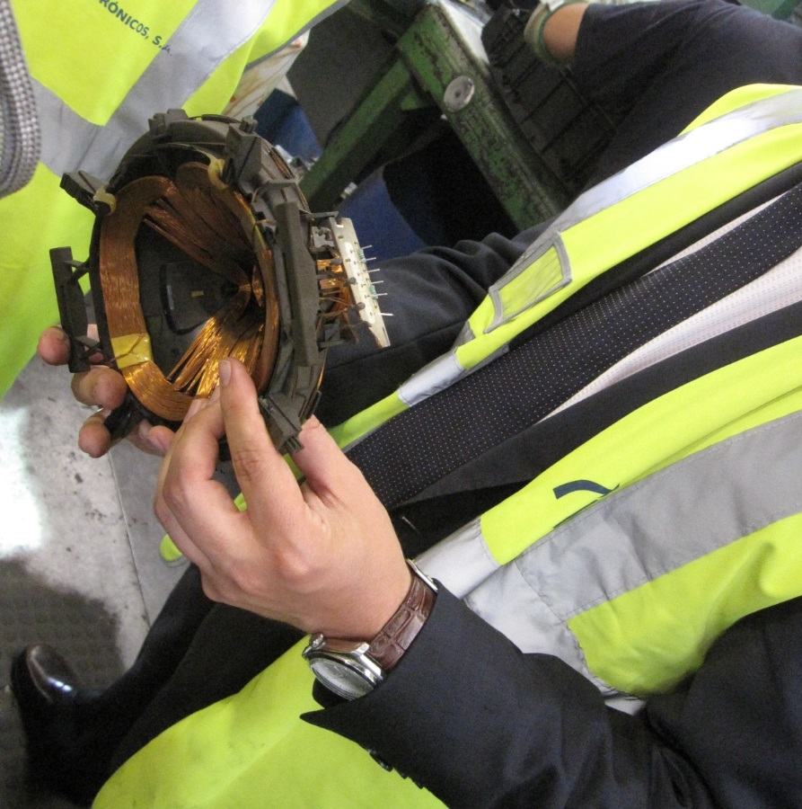
Nature of the project
CWIT’s funding scheme was a coordination and support action.
The project had an intelligence-based approach.
Activities:
Intensive data collection.
Stakeholder involvement (surveys, workshops).
Notes:
JH
Stress the fact that we are not to discover anything new. We just put data already existing together and analyze it.

Slide 3
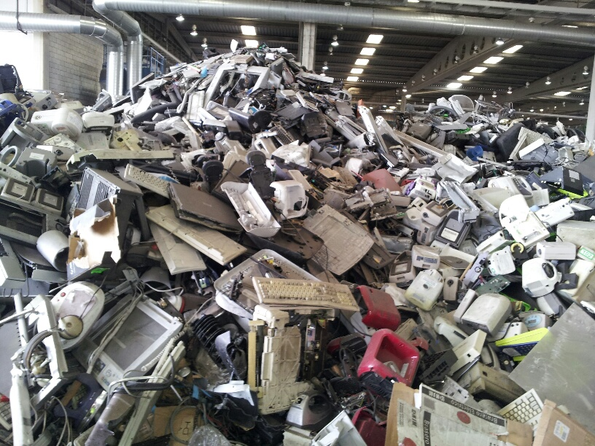
Unique comprehensive analysis
How much WEEE arises in Europe every year?
Who is trading, how much, with whom? Where does WEEE end up? What drives illegal trade?
Is the legal framework sufficiently clear and unambiguous?
Are Organised Crime Groups involved?
What do we recommend to address the situation?
Notes:
JH
Who is trading, how much, with whom. Where does WEEE end up? What drives illegal trade?
Is the legal framework sufficiently clear and unambiguous?
Are Organised Crime Groups involved?
How can we improve the situation?

Slide 4



2012 EU WEEE flows
?
Where is the rest? How much in:
  Waste bin
  Complementary or ‘non-compliant’ recycling
  Scavenged parts
  Export as UEEE
  Export as WEEE
Notes:
JH

Slide 5
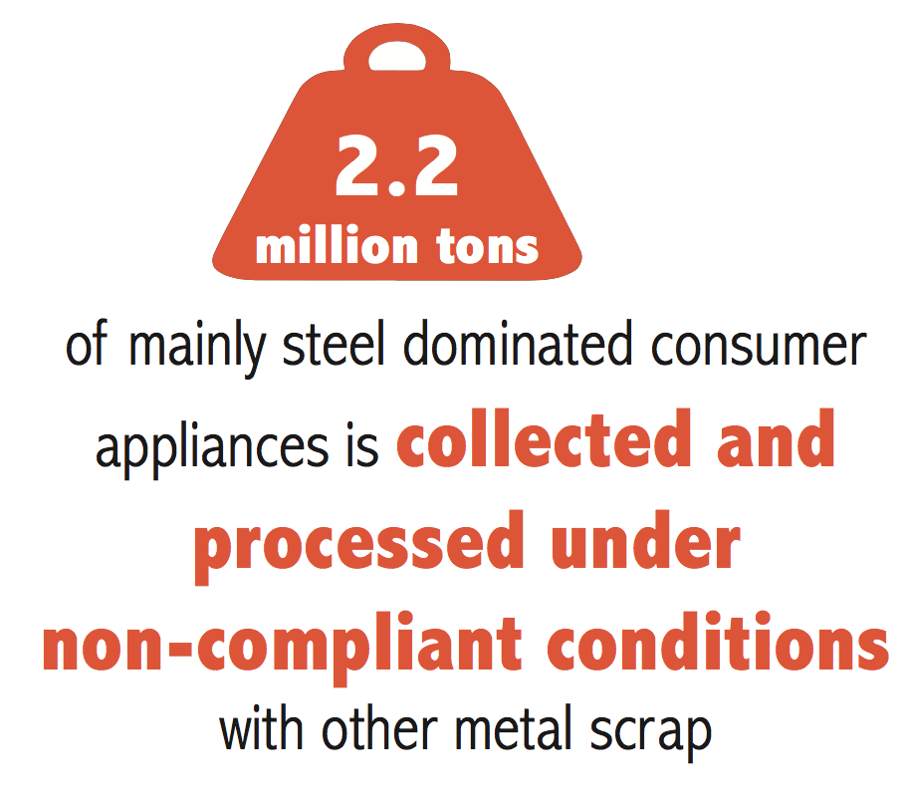
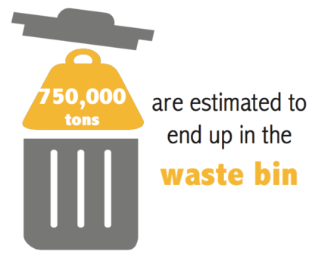
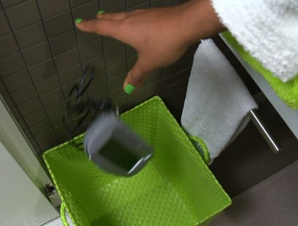
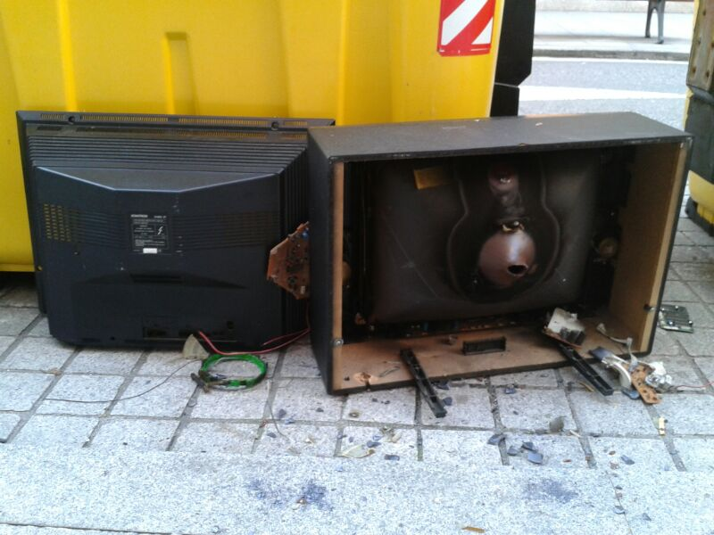
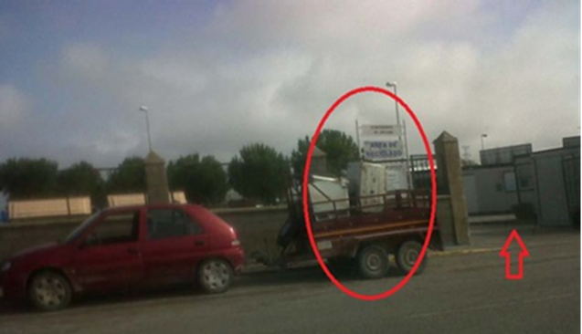
2012 EU WEEE flows
Notes:
JH

Slide 6
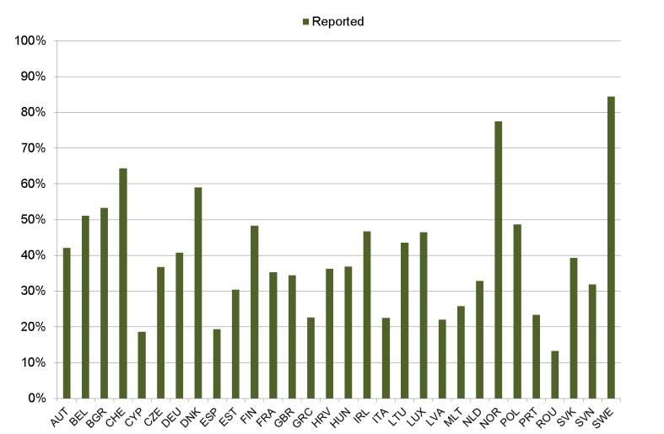
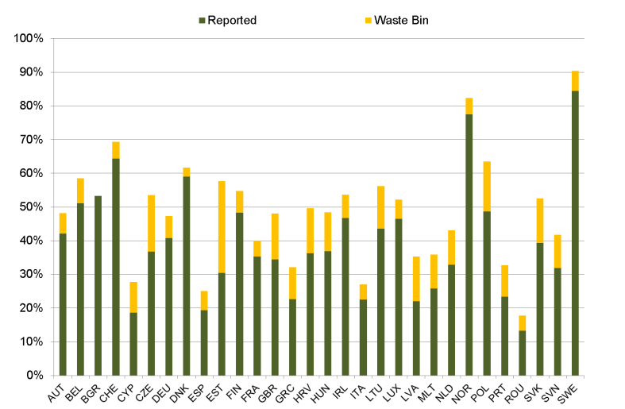
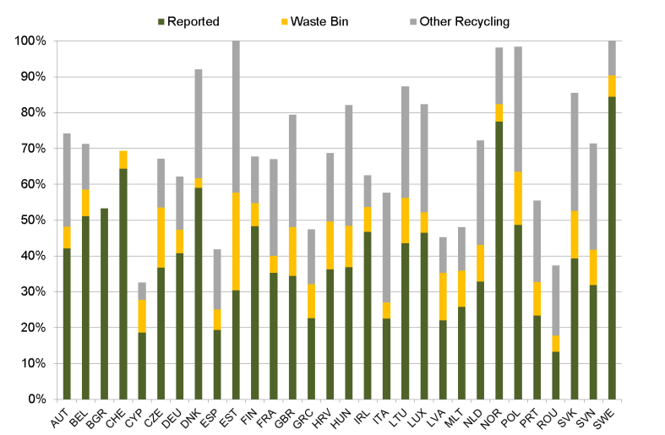
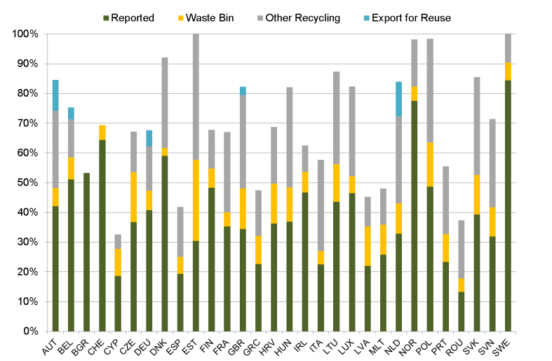
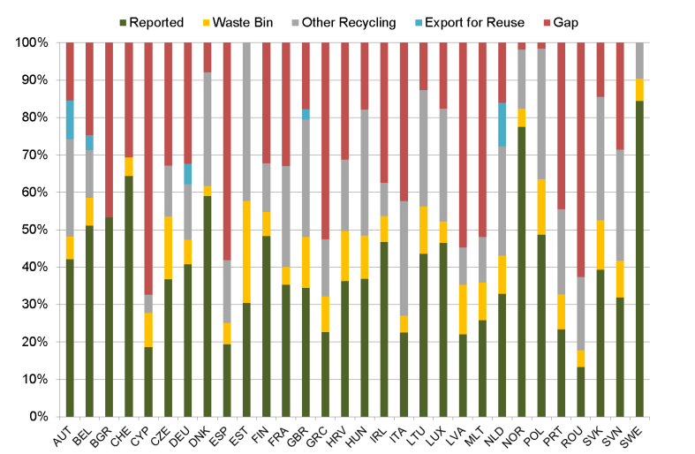
EU WEEE flows, 2012
85%
Notes:
JH
Data also per collection category
Some negative gaps: there is misreporting even for ‘official amounts’.
Remarks per country/ collection category:
Waste bin is consumer behavior mainly.
Grey is conservative estimate, excl. scavenging of components, professional appliances
Data per collectoin category is also possible.

Slide 7
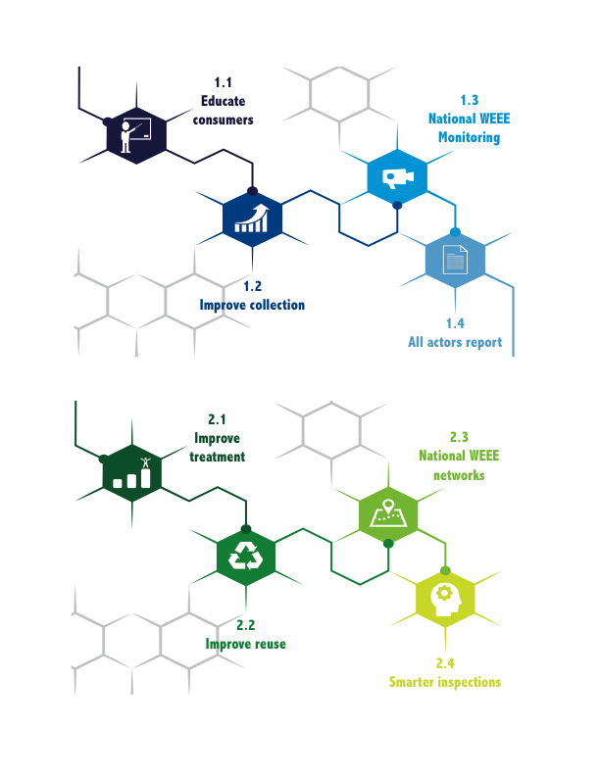
Cluster I: Collect more, prevent leakage
Notes:
LH

Slide 8


Cluster I
Run attitudinal surveys (investigate motivations for users).
Communication campaigns for end users to raise awareness.
Assess the possibility of running law enforcement campaigns for end users (tackle fly tipping and improper curbside disposal).
Notes:
LH
Roll out communication campaigns for end users to raise awareness around the proper disposal of WEEE.
• Run attitudinal surveys to investigate motivations and potential incentives for users in support of
communication campaigns.
Assess the possibility of running law enforcement campaigns for end users to tackle fly tipping and improper curbside disposal of WEEE.

Slide 9


Cluster I
Collection points more easily accessible and more visible.
Increase the number of collection points.
Improve security at collection points.
Introduce a ban on cash transactions.
Notes:
LH
Make collection points more easily accessible and more visible.
• Increase the number of collection points or their territorial density.
• Improve security at collection points.
• Introduce a ban on cash transactions to reduce the profitability of unlawful activities and the viability of
cash transfers related to WEEE illegal trade.

Slide 10

Cluster I
• Improve local monitoring and benchmarking in all collection points
• Improve access to information (specific lists for WEEE related companies, standard terminology for activities and actors).
• Develop a national WEEE monitoring strategy.
• Improve methods for calculating e-waste indicators (basis for national mass balance)
Notes:
LH
Improve local monitoring and benchmarking in all collection points, including civic amenities and retail
outlets.
• Improve access to information by creating specific lists for WEEE related companies, including the availability
of contact details of the entity managing the register, and standardising terminology to describe different
activities and actors.
• Develop a national WEEE monitoring strategy.
• Improve current methods for calculating e-waste indicators that form the basis for national mass
balance calculations.

Slide 11

Cluster I
• Reporting obligations for all actors collecting WEEE.
• Use an unequivocal description of WEEE for reporting.
• Same codes or codes that allow comparability in reporting processes.
• Control system of data collected (data consistency and reliability)
Notes:
LH
Establish reporting obligations for all actors collecting WEEE products.
• Use an unequivocal description of WEEE that is understood by all actors reporting.
• Use the same codes or use codes that allow comparability in reporting processes.
• Establish a control system of data collected that will assess consistency and reliability of the data reported
by actors.

Slide 12
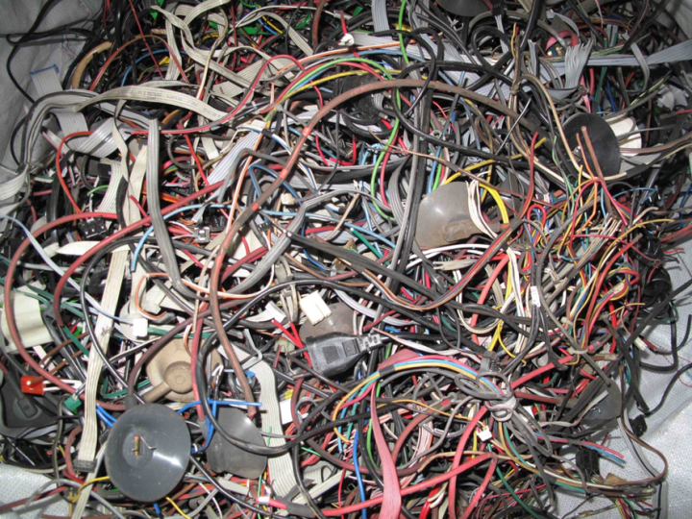


2012 EU WEEE flows
Notes:
JH

Slide 13
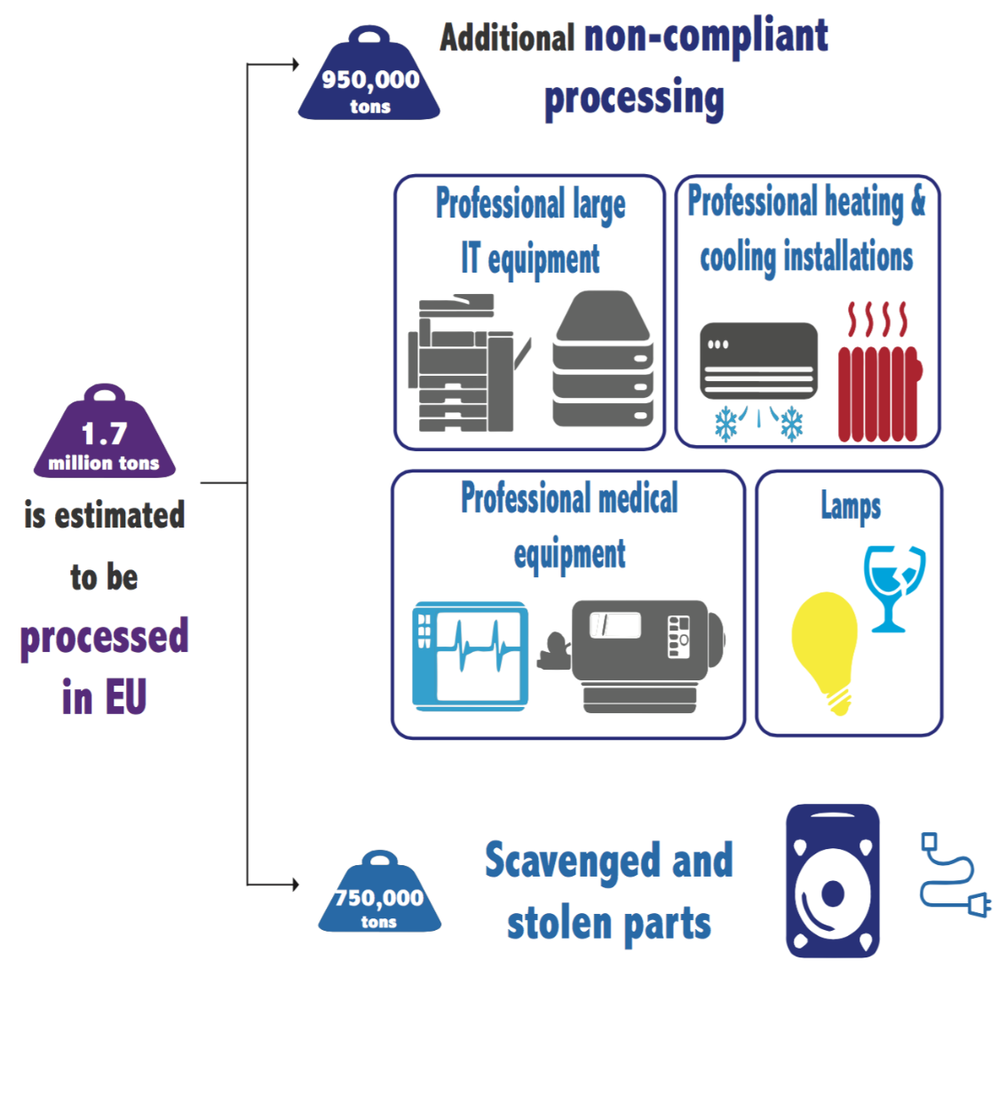
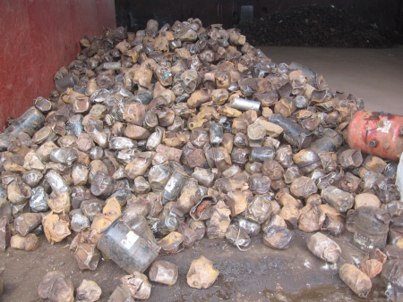
Scavenging components
Large deviations per country from EERA survey (covering 1M tons):
Missing compressors in fridges: 30% (average reported, range 15%-50%)
HDD and PCB in desktops and laptops: 35% (average, range 10%-70%)
Damage to WEEE industry:
Loss of valuable materials
Grey economy
Unreported WEEE flows
Environmental damage
Notes:
JH
Based on EERA response: cable and yokes/ TVs not asked.
Around 350 M€ in intrinsic material value is not present anymore in the collection streams when arriving at pre-processing*. * Rough estimate for these two types of cherry picking alone.
There is clearly an existing market for these materials that benefits from :
cash transactions, lack of up/downstream monitoring, ambiguous codification for WEEE components.
128 g/ per fridge of 38.2 kg of CFC 12 in compressor
2.84 kg CFC 12 per tonne of C&F
57% CFC containing 30% compressor removed
1.62 for all fridges, kg CFC12 to air per ton fridges
10.9 direct GWP in ton Co2 per kg substance, IPCC 2007 in kgCO2/ kg CFC12
1,059,307 WG C&F, tonnes (only 0108+0109)
5,616,194 ton CO2 lost
modern car 2014: 125g/ km
10.816 km annually
1.35 ton per year per car.
Equals 4,153,989 modern passenger cars on the road

Slide 14
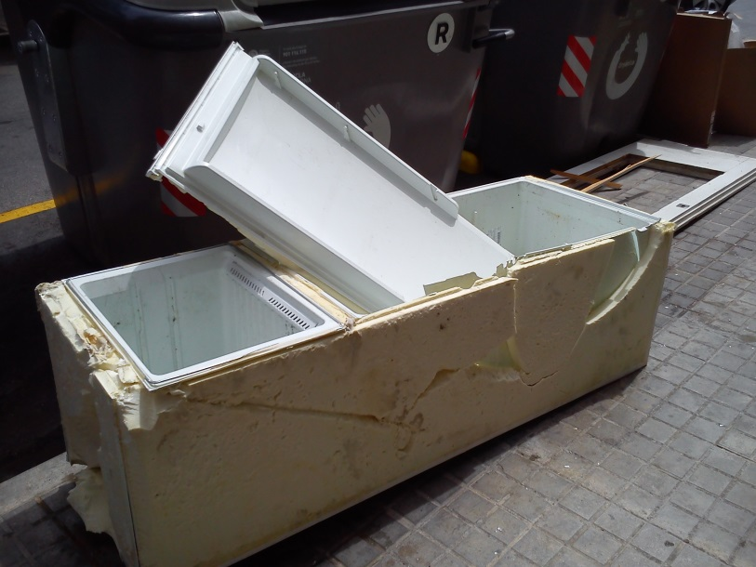
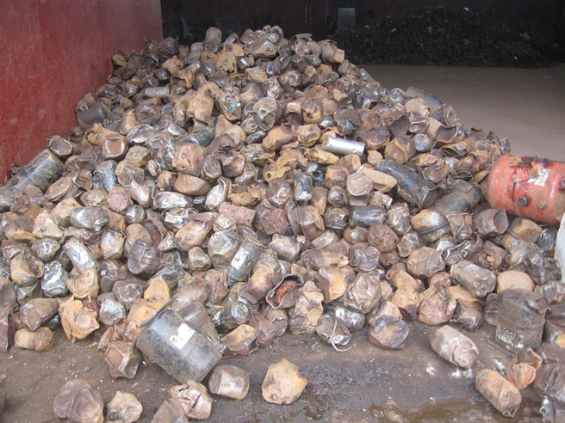
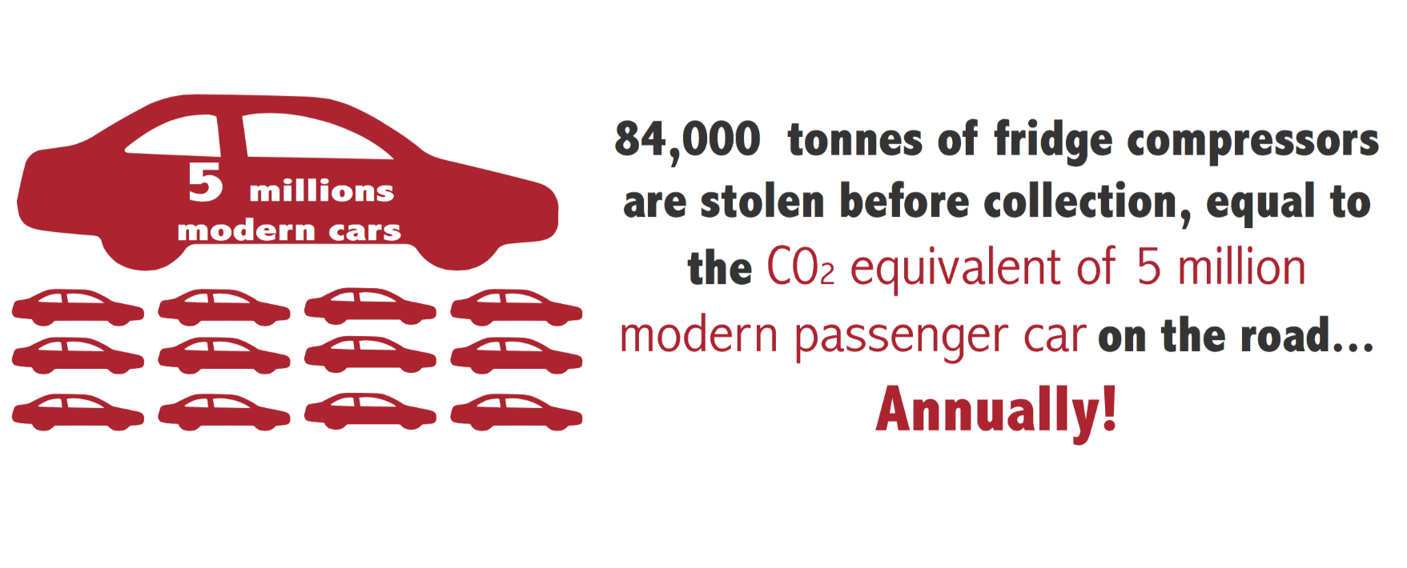
Scavenging components
Notes:
JH
Based on EERA response: cable and yokes/ TVs not asked.
Around 350 M€ in intrinsic material value is not present anymore in the collection streams when arriving at pre-processing*. * Rough estimate for these two types of cherry picking alone.
There is clearly an existing market for these materials that benefits from :
cash transactions, lack of up/downstream monitoring, ambiguous codification for WEEE components.
128 g/ per fridge of 38.2 kg of CFC 12 in compressor
2.84 kg CFC 12 per tonne of C&F
57% CFC containing 30% compressor removed
1.62 for all fridges, kg CFC12 to air per ton fridges
10.9 direct GWP in ton Co2 per kg substance, IPCC 2007 in kgCO2/ kg CFC12
1,059,307 WG C&F, tonnes (only 0108+0109)
5,616,194 ton CO2 lost
modern car 2014: 125g/ km
10.816 km annually
1.35 ton per year per car.
Equals 4,153,989 modern passenger cars on the road

Slide 15
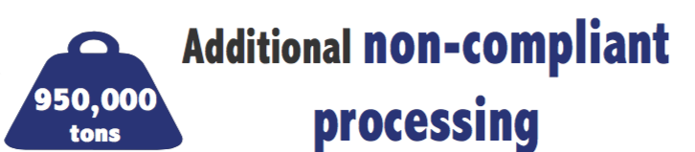
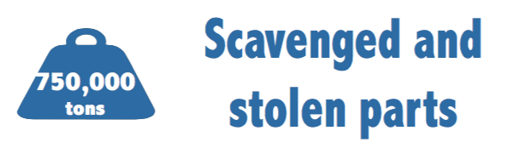

2012 EU WEEE flows
Notes:
JH

Slide 16
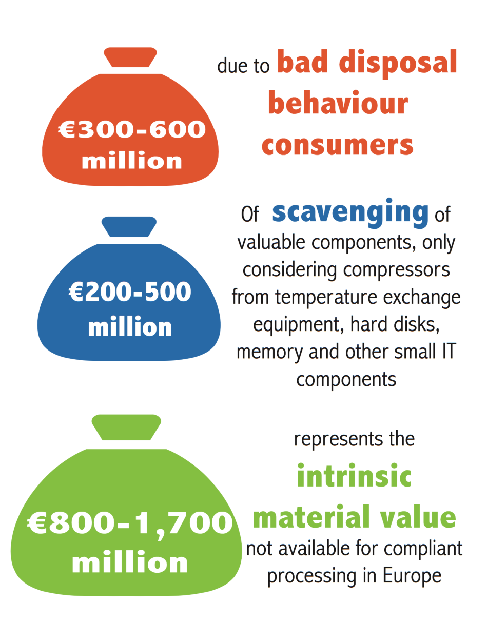
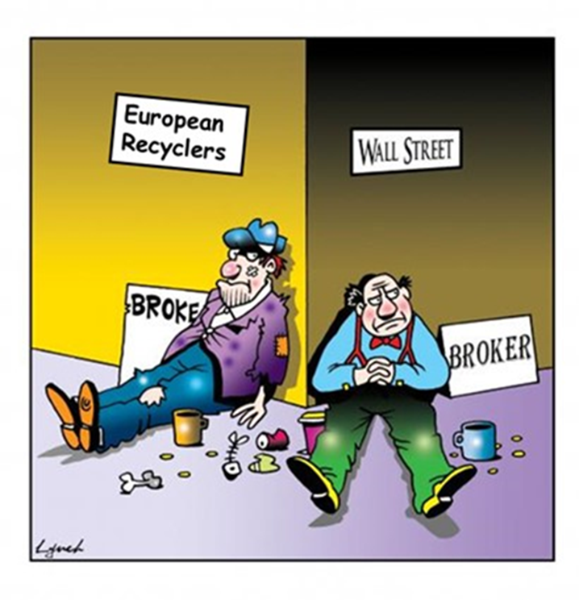
Economic impact on EU economy
+ 150 to 600 M € in avoided compliance costs
Notes:
JH

Slide 17
Cluster II: Trading, treatment and economic drivers
Notes:
LH

Slide 18

Cluster II
• Implement (mandatory) WEEE standards.
• Improve reporting on treatment within and outside of Europe.
• Improve the economics of de-pollution.
• Improve treatment in developing countries.
Notes:
LH
Implement (mandatory) WEEE standards.
• Improve reporting on treatment within and outside of
Europe.
• Improve the economics of de-pollution.
• Improve treatment in developing countries.

Slide 19

Cluster II
Harmonised definitions for reuse, preparation for reuse and refurbishment.
Harmonise reuse standards and guidelines.
Training and capacity building for the refurbishment/reuse industry.
Notes:
LH
Use harmonised definitions for reuse, preparation for reuse and refurbishment.
• Develop and harmonise reuse standards and guidelines.
• Provide training and capacity building for the refurbishment/reuse industry.
• Establish green reuse channels and approved reuse centers, under the precondition that sufficient
upstream inspections take place, the various guidelines for testing and packaging are fully
implemented and no bypassing of the Basel Convention/ Waste Shipment Regulations is created.

Slide 20

Cluster II
Establish National Environmental Security Task Forces (NEST)
Enhance multi-stakeholder networks in programmes aimed at tackling WEEE illegal trade.
Notes:
LH
Establish National Environmental Security Task Forces (NEST) to ensure a coordinated multi-agency
response to tackle the illegal trade in WEEE.
• Enhance multi-stakeholder networks by involving different types of stakeholders in programmes aimed
at tackling WEEE illegal trade.

Slide 21
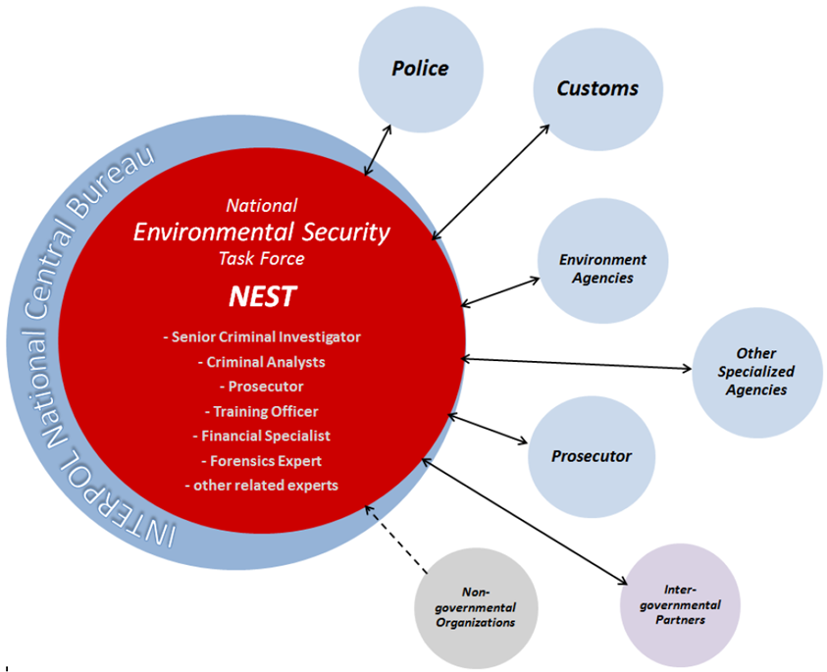
Cluster II
Notes:
LH
>> Time to look at the legal framework.

Slide 22

2012 EU WEEE flows
Notes:
JH

Slide 23
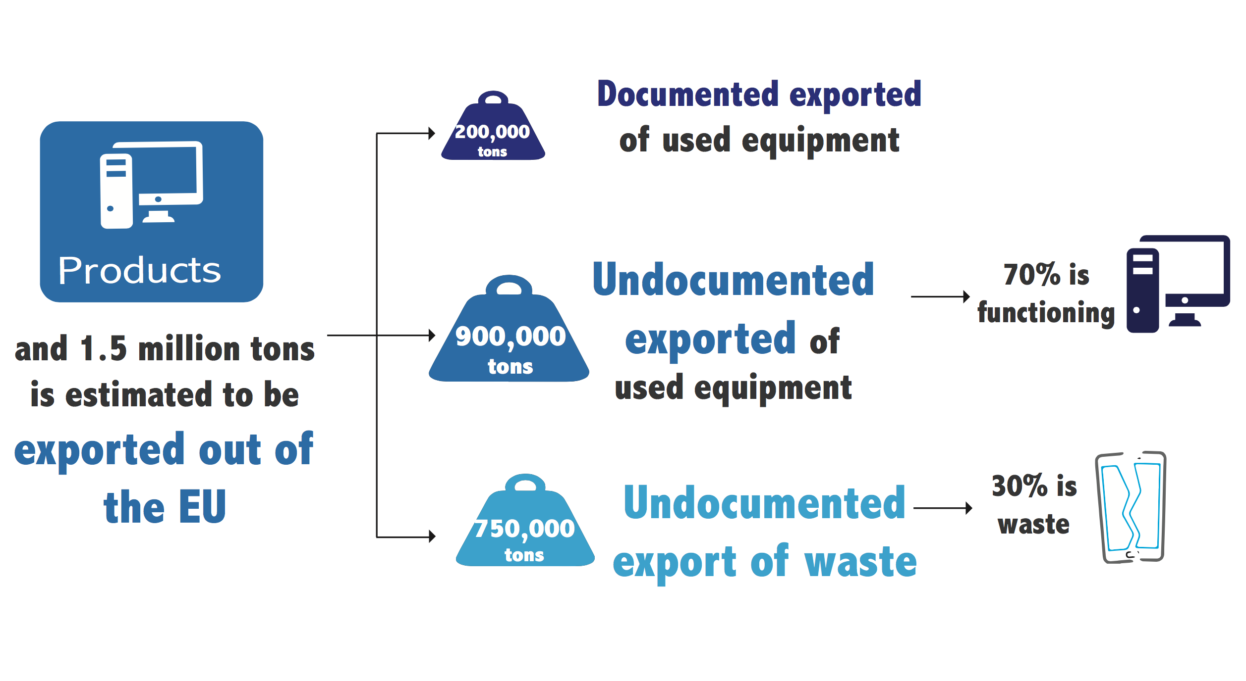
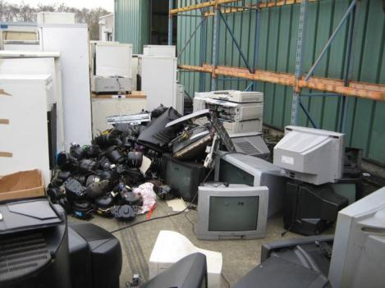
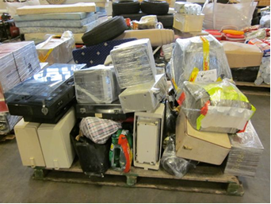
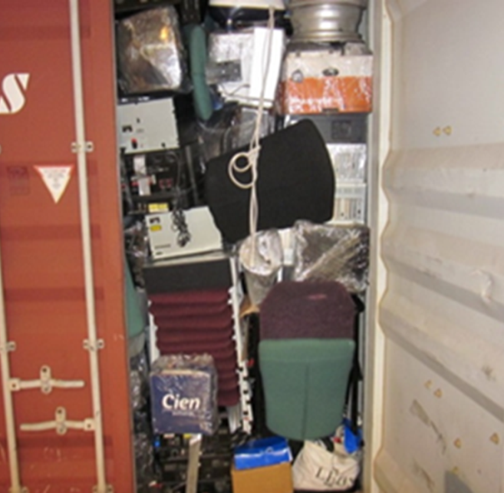
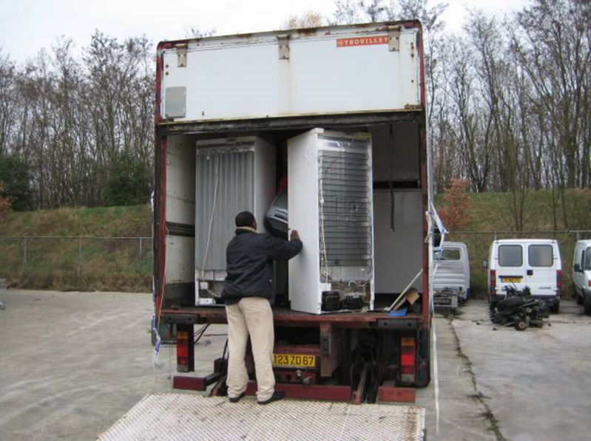
Notes:
JH

Slide 24


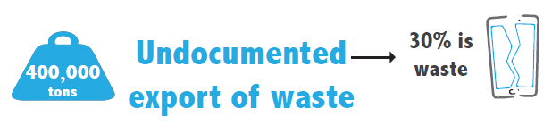
2012 EU WEEE flows
Notes:
JH

Slide 25

Cluster II
More effective inspections (targeted inspections, intelligence-led risk assessments and improved detection techniques)
Improve WEEE investigations through better investigative procedures.
More and smarter upstream inspections of facilities in order to prevent illegal activities moving downstream.
Notes:
LH
Ensure more effective and successful inspections through targeted border inspections, intelligence-led
risk assessments and improved detection techniques.
• Improve WEEE investigations through better investigative procedures.
• More and smarter upstream inspections of facilities in order to prevent illegal activities moving downstream.

Slide 26
Cluster III: The legal framework, implementation and enforcement
Notes:
LH

Slide 27

Waste Classification Codes
UNU Keys
(54)
>660 product
types
Custom codes
(CN ≈ 300)
WEEE Directive (10) and Recast (6)
Basel Codes (Annex VIII)
EU List of Waste (839)
unrelated
Correspondence table
unrelated
Correlated
← 1:n, → splitfactor
Correlated
← 1:n, → splitfactor
unrelated
  See also: http://ias.unu.edu/en/research/e-waste-quantification.html#outputs
Notes:
LH
LoW to UNU Key and WEEE Dir is partly easy to make (1:n), they are in dev by DG Taxud, some difficulties
WFD leave up to the waste holder the role of waste characterization (and picking the EWC is one part of it)
If you prescribe (don’t know if possible) unique EWC for some waste streams you have first to check if the waste permits issued in one country (authorized treatment capacity) are matching the WG.
Member States will probably prefer to keep “free hands” on this.

Slide 28


Cluster III
Import/export codes for WEEE and second-hand commodities
Consistent interpretation of waste vs non-waste.
Collaboration and agreement towards more harmonized WEEE classifications and definitions.
Develop compatibility tables (converting
customs codes into Basel codes)
Notes:
LH
Develop import/export codes for WEEE and second-hand commodities to differentiate between
new and used equipment and allow tracing of important types of WEEE such as monitors, TVs and
refrigerators.
• Have a consistent interpretation of waste versus non-waste. A global definition of WEEE is essential for
all actors involved in the fight against illegal trade in WEEE.
• Encourage collaboration and agreement between stakeholders to progress towards more harmonised
WEEE classifications and definitions.
• Develop compatibility tables to allow for converting customs codes into Basel codes and vice-versa
through the adoption of the UNU Keys. This would improve waste codification by connecting the various
classifications of WEEE and commodities.

Slide 29
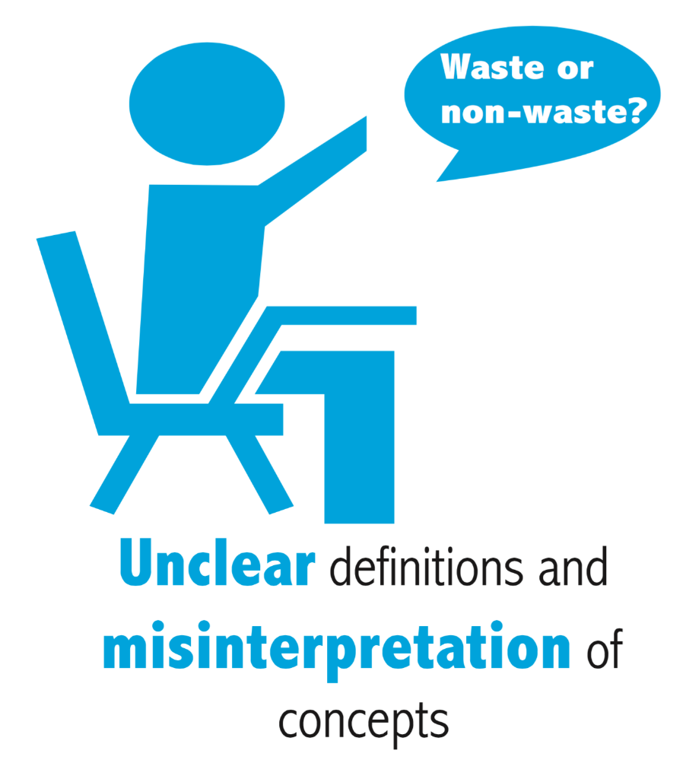
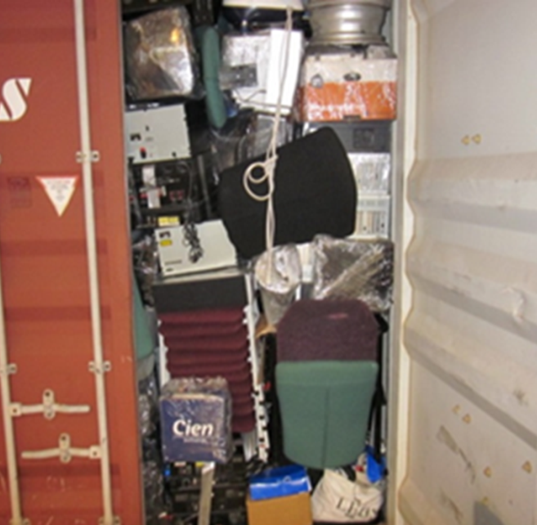
Waste or used EEE?
Distinguishing waste from non-waste is critical for all actors in the WEEE chain
There is no global definition/ scoping of ‘WEEE’
Uncertainty leads to opportunities for WEEE concealed and falsely declared as UEEE
Lack of clarity is a major obstacle in the prosecution of cases (EUROJUST)
Notes:
LH
Various definitions and guidelines related to WEEE exist at national, regional and international levels

Slide 30

Cluster III
Improve the availability of existing guidelines.
Support and training to authorities.
Campaign for official endorsement of guidelines by relevant authorities.
Identify and select the organisation(s) to own/sponsor new guidelines.
Notes:
LH
Improve the availability, awareness and understanding of existing guidelines.
• Provide sufficient support and training to authorities (see Cluster 3.3 below).
• Develop certification in the use of guidelines (e.g. ISO).
• Campaign for official endorsement of guidelines by relevant authorities.
• Identify and select the organisation(s) to own/sponsor new guidelines.

Slide 31


Cluster III
Establish centres of excellence and/or an EU waste agency.
Specialised training for personnel.
Facilitate cross-border inter-agency capacity training (stakeholders export and import of WEEE).
Establish public-private partnership schemes (between LEAs and the WEEE industry).
Notes:
LH
Establish centres of excellence and/or an EU waste agency.
• Provide specialised training for personnel (law enforcement, environmental inspectors, customs etc.).
• Facilitate cross-border inter-agency capacity training, between stakeholders involved in both the export and
import of WEEE.
• Establish public-private partnership schemes (between LEAs and the WEEE industry).

Slide 32
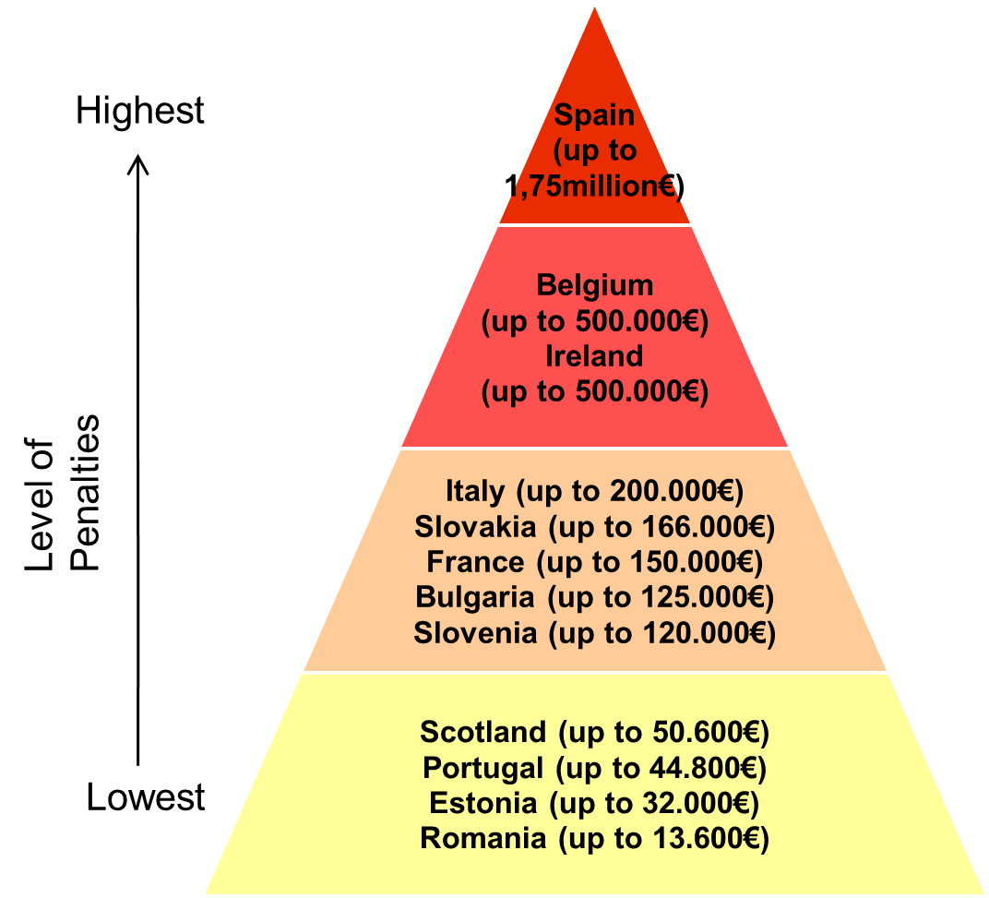

Financial penalties
Low probability of prosecution & sentencing
Current penalties are not a deterrent – usually only administrative in nature
Fines imposed are often less than the profit of one illegal shipment
More stringent penalties would reduce the attractiveness of illegal WEEE activities
Harmonizing penalties would reduce the risk of displacement of crime
Notes:
LH

Slide 33

Cluster III
Assess national penalty system (sanctions proportionate and dissuasive).
Increase penalty levels for natural persons who are company representatives.
Harmonise offences and penalty types related to WEEE crimes at EU level (wording, definitions and severity).
Adjust the penalty system to organised crime
Notes:
LH
Assess the national penalty system to ascertain if sanctions are proportionate and dissuasive.
• Increase penalty levels for natural persons who are company representatives.
• Harmonise offences related to WEEE crimes at EU level (wording, definitions and severity).
• Harmonise penalty types at EU level.
• Adjust the penalty system related to organised crime (i.e. specific penalties to tackle organised crime
involvement in WEEE illegal activities)

Slide 34
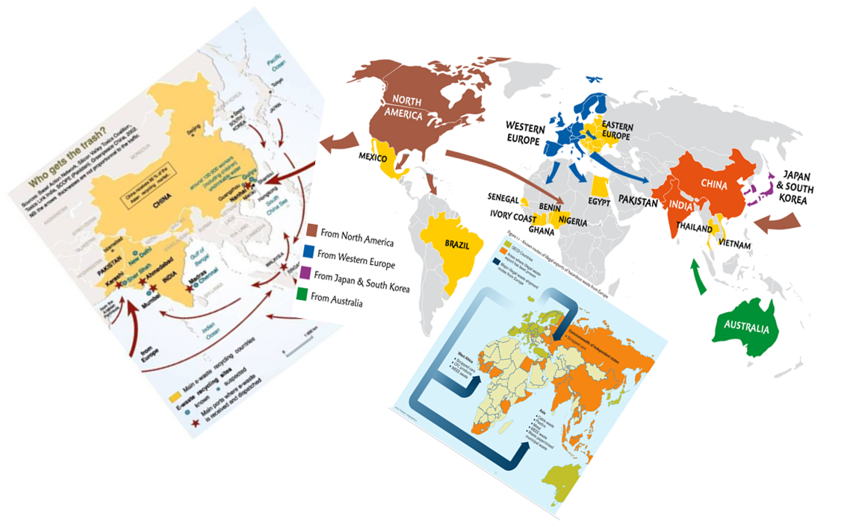
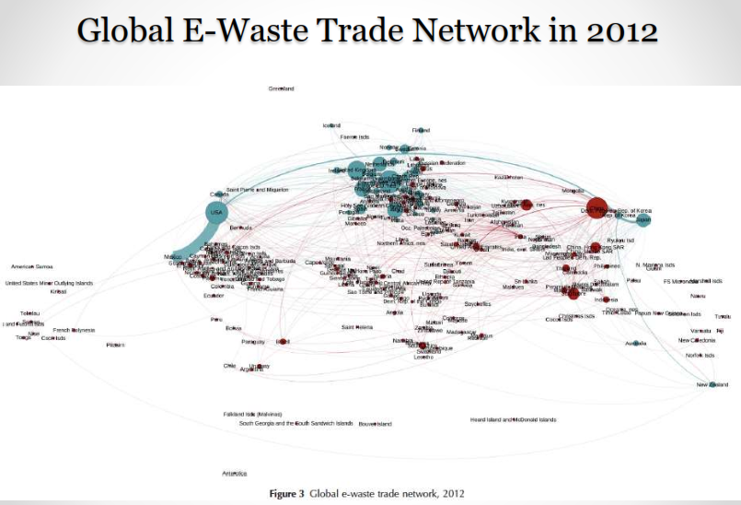
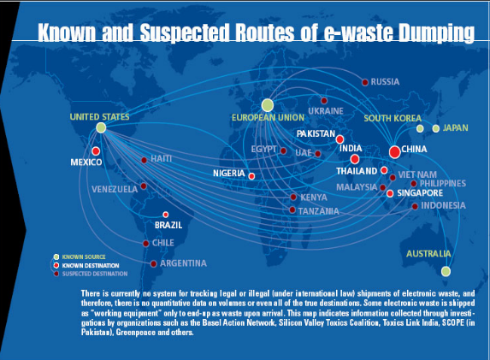
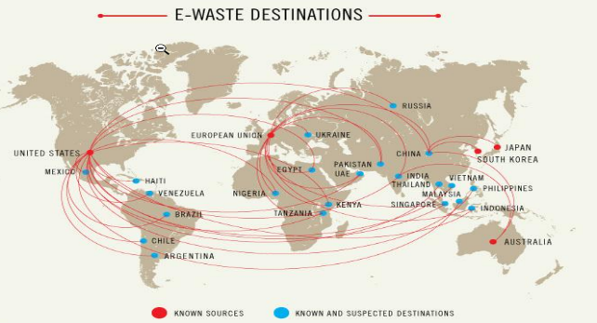
Where is the gap?
Notes:
JH

Slide 35
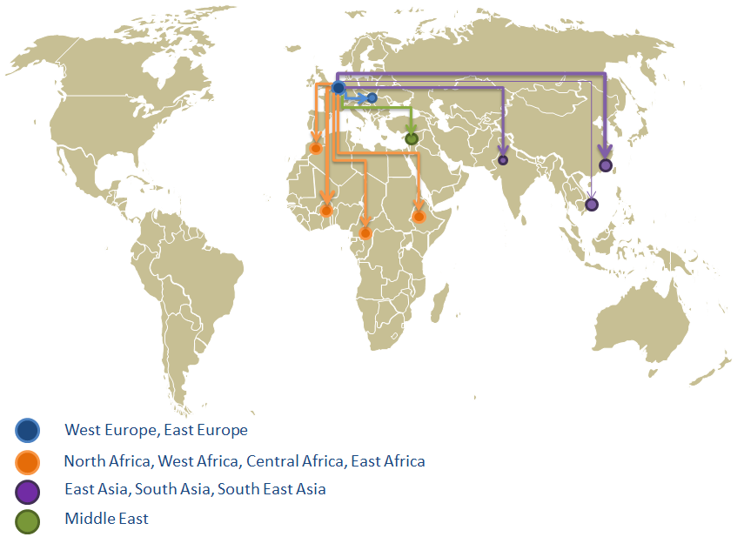
WEEE routes
Notes:
JH
Even though the main destination reported is West Africa (Nigeria, Ghana, Benin, Ivory Coast), there were also exports to North Africa (Morocco), Central Africa (Cameroon) and East Africa (Uganda, Tanzania, Zanzibar). There were also cases of export to the Middle East (Israel and Lebanon) and to Asia (Vietnam, Hong Kong and Pakistan).
In addition there were cases in which WEEE was transported from West Europe to East Europe.
Add data from previous slides
Give rough estimate from D4.3 per destination

Slide 36
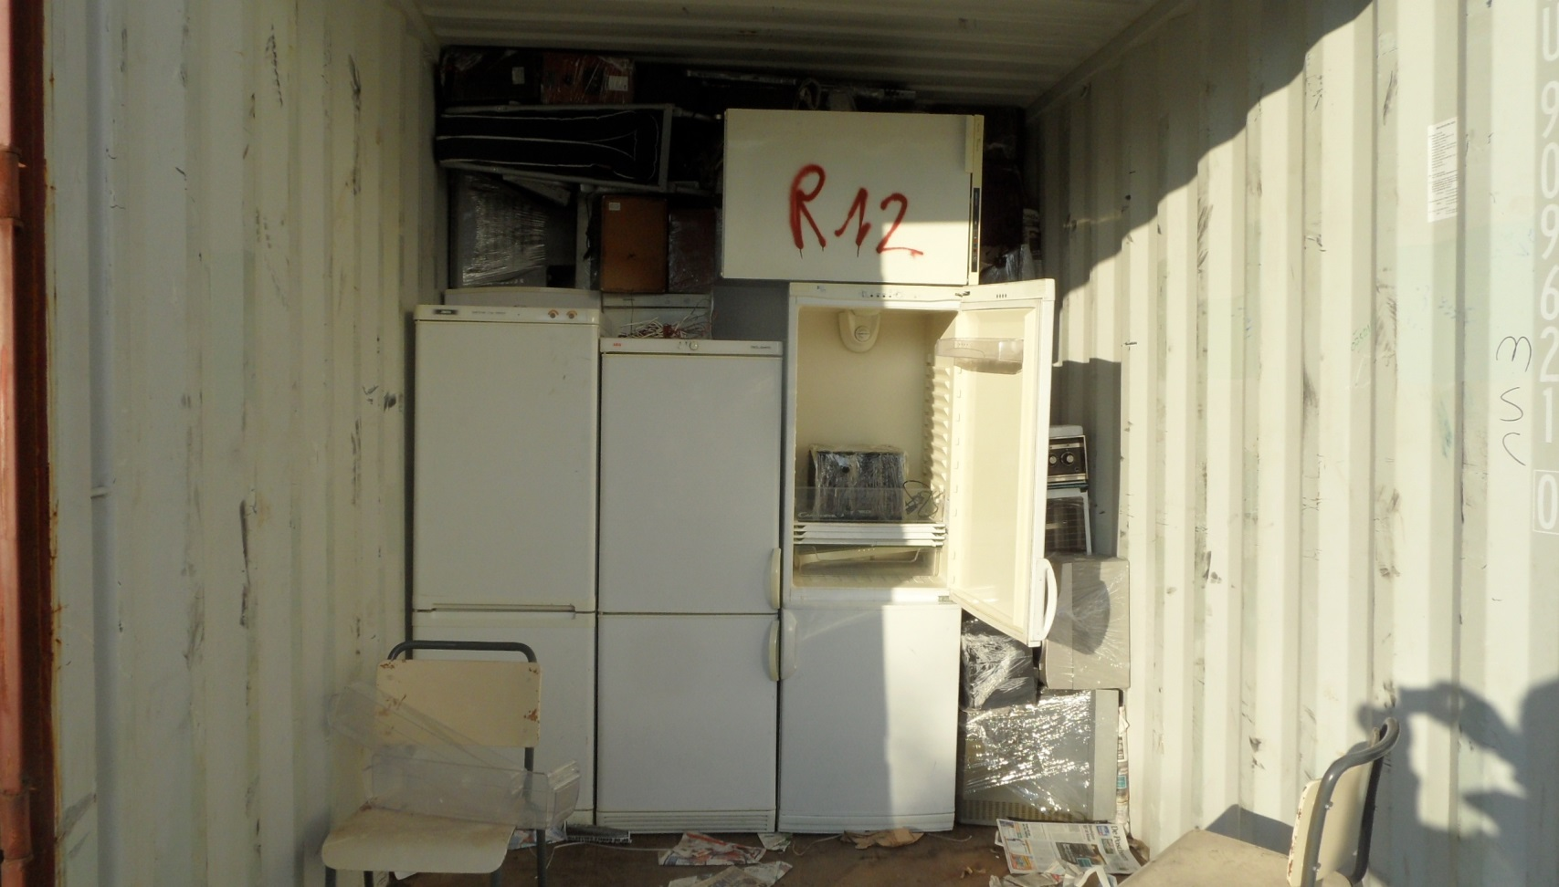
2012 EU WEEE flows
Notes:
JH

Slide 37
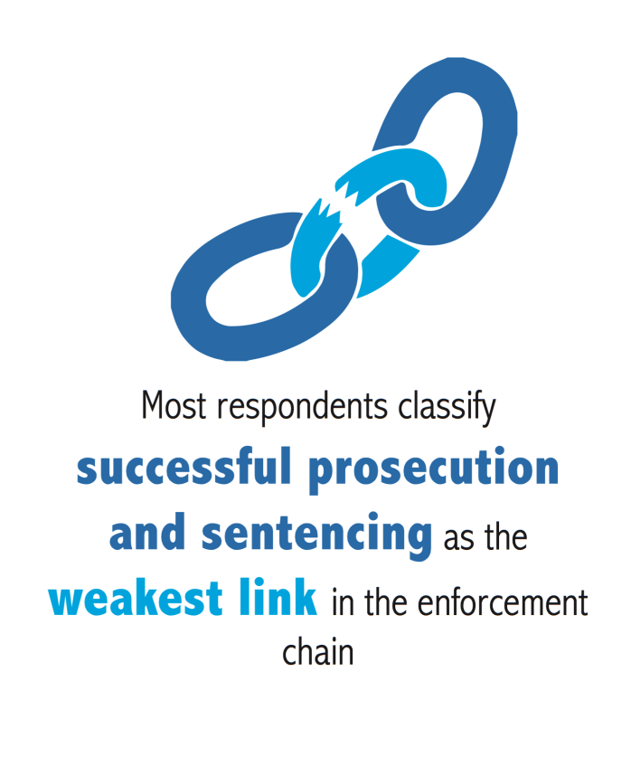
More enforcement?
▪
only 2,000 tons seized & prosecuted
Notes:
JH

Slide 38
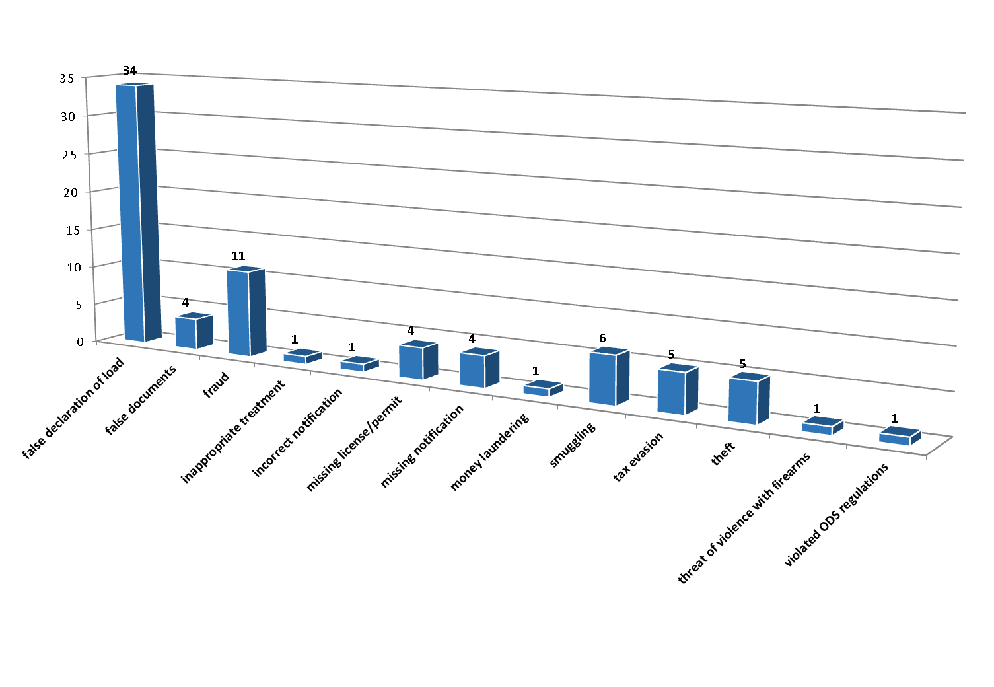
Main types of violations
False declaration of the load by far the most significant offence committed
Notes:
LH
CWIT project also analyzed the number of committed offences, it is obvious that there is a significant difference between the predominant committed offence “false declaration of the load” and the remaining identified offences.
Picture of WEEE illegal trade.
Collection of cases on illegal trade.
Criminal activities related to illegal trade of WEEE.

Slide 39
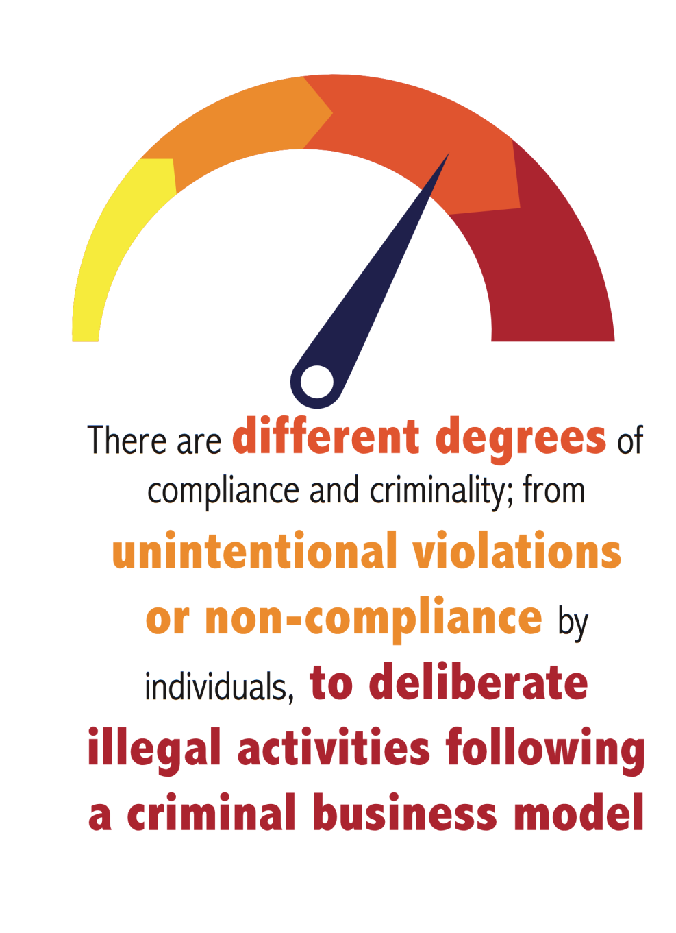
Modus operandi
Inadequate declaration of products as “used goods”
False documents to conceal actual loads
Using forged documentation for transport, export and border controls
Involved are:
Treatment facilities
Logistic companies
Dealers, brokers, etc.
Loading sites
Companies involved in management of int. shipments
Non-profit organisations
Notes:
LH

Slide 40
Cluster IV: Enforcement and Prosecution
Notes:
LH

Slide 41

Cluster IV
Agreements for the exchange of information between law enforcement, judicial authorities and the WEEE industry.
Operational Intelligence Management System (OIMS) for the planning of law enforcement actions.
Intelligence to prioritise and direct resources towards most effective actions.
National intelligence model
Notes:
LH
Put in place formalised agreements for the exchange of information between law enforcement, judicial
authorities and the WEEE industry.
• Consolidate and implement an Operational Intelligence Management System (OIMS) that enables the secure
input, management, development, analysis and dissemination of intelligence and critical information
especially during the planning of law enforcement actions.
• Use intelligence to prioritise and direct resources towards the operations and policies that will be most
effective in combating crime.
• Build or consolidate a national intelligence model to implement a full set of best practices in intelligence-led
policing and law enforcement, including a framework to better achieve the priorities highlighted in each
country’s public safety strategy.

Slide 42
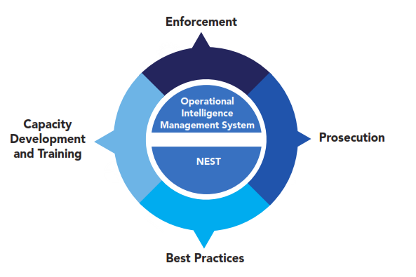
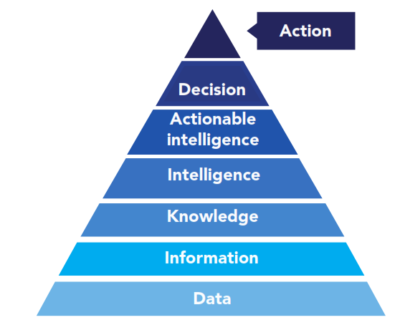
CONOPS (Concept of Operations)
Notes:
JH

Slide 43

Cluster IV
Human resources and equipment.
Exchange of inspectors across competent authorities
Allocate staff based on risk assessment
Strengthen the capacity of existing networks, such as Europol and INTERPOL.
Notes:
LH

Slide 44

Cluster IV
Participate in international waste operations and enforcement actions (global co-operation).
Create an EU waste implementation agency (training and education, platform to exchange knowledge and best practices).
Notes:
LH
Participate in international waste operations and enforcement actions to achieve international
co-operation at a global level by bringing together neighbouring countries to target waste and WEEE trade/operations.
• Create an EU waste implementation agency to support Member States through training and education,
and to act as a platform to exchange knowledge and best practices.

Slide 45

Cluster IV
Improve the capacity and resources of prosecutors and judges.
Improve communication and co-operation among prosecutors and judicial authorities (database of information, contact points and joint investigation teams)
Increase role of EU and international networks (EUROJUST)
Notes:
LH
Improve the capacity and resources of prosecutors and judges.
• Improve communication and co-operation among prosecutors and judicial authorities in order to
establish a database of information, contact points and joint investigation teams. This recommendation
also suggests increasing the role of European/international networks such as EUROJUST.

Slide 46
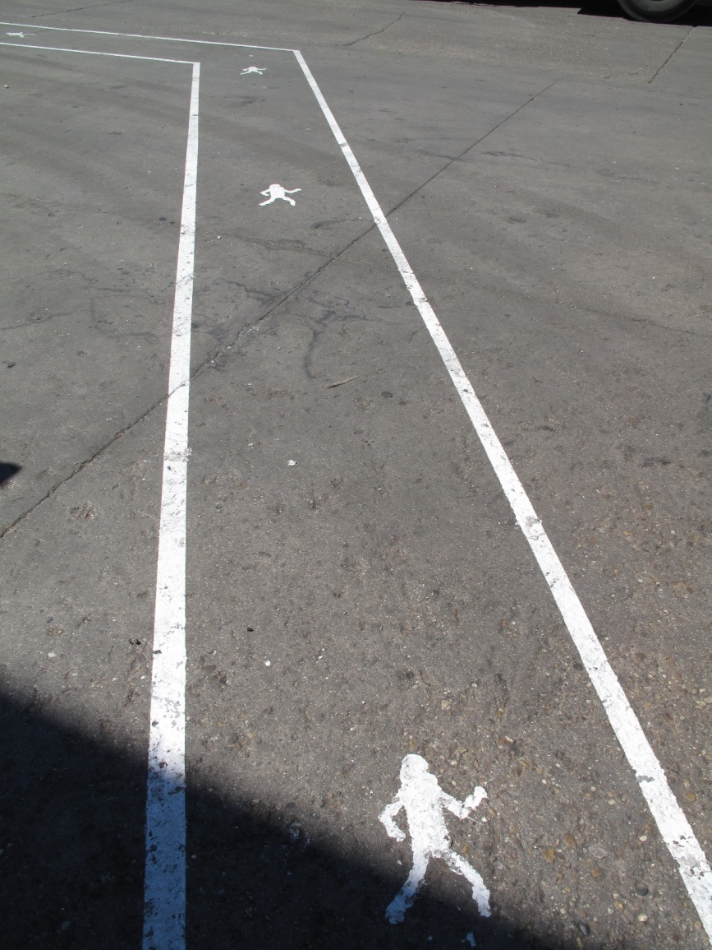
Roadmap
Notes:
JH
Categorisation of measures

Slide 47
The CWIT roadmap
Notes:
JH
Arrangement by short, medium and long term implementation

Slide 48
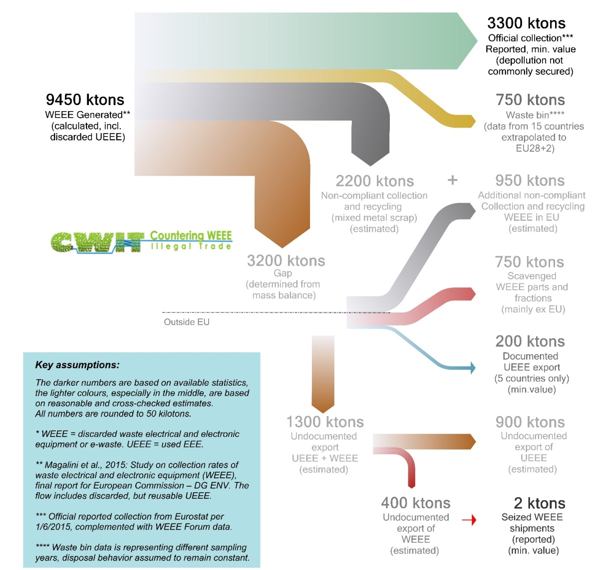
Are these numbers more plausible?
Supported by individual mass balances (per collection category)
Reported plus non-reported recycling total confirmed by circuit boards amounts (smelters)
The percentage of UEEE to developing countries is >70%
Matches observations of individual country studies
Confirmed by analysis of economic drivers
Notes:
JH

Slide 49
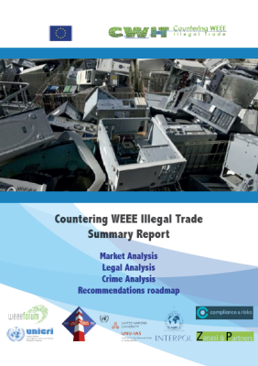
Are these numbers more plausible?
See www.cwit-project.eu for the Summary Report
Notes:
JH

Slide 50
Thank you!
Here is more information:
See www.cwit-project.eu for the Summary Report incl. an extended recommendations roadmap
http://www.libraweee.eu/
http://www.cwitproject.eu/reports-downloads/database-ewaste-stakeholders/
Notes:
JH

Slide 51

Thank you for your attention
huisman@unu.edu
Lucia.herreras@weee-forum.org
This project and the research leading to these results has received funding from the European Community's Seventh Framework Programme (FP7/2007-2013) under grant agreement n° 312605
Notes:
JH

Slide 52
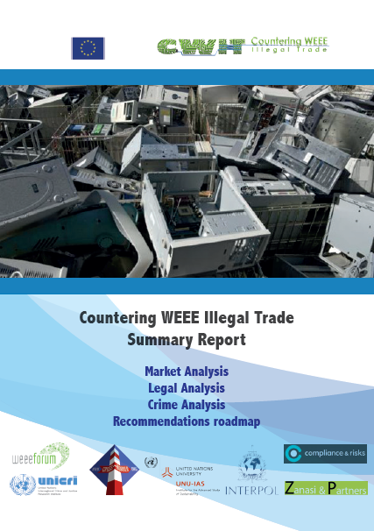


UNU E-waste Quantifications: Products
2013-2015: “What’s the size and nature of WEEE illegal trade?”
  CWIT: Countering WEEE Illegal Trade (see www.cwit-project.eu)
Notes:
JH
Needs animation

